Slide 1
上机：线性回归和方差分析

Slide 2

下载R

Slide 3


Slide 4

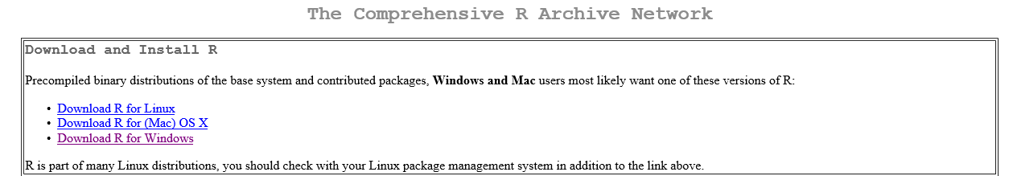
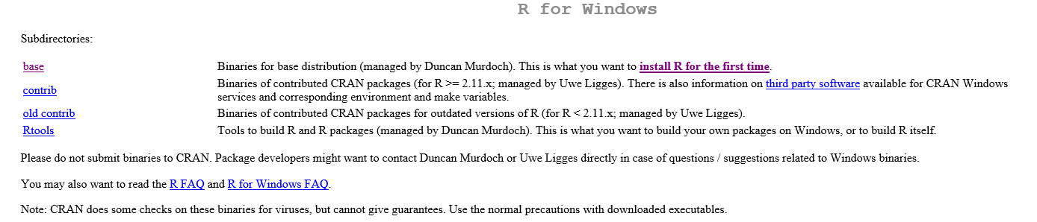

Slide 5
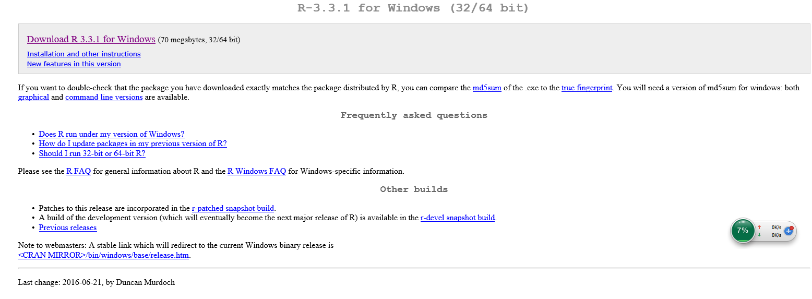
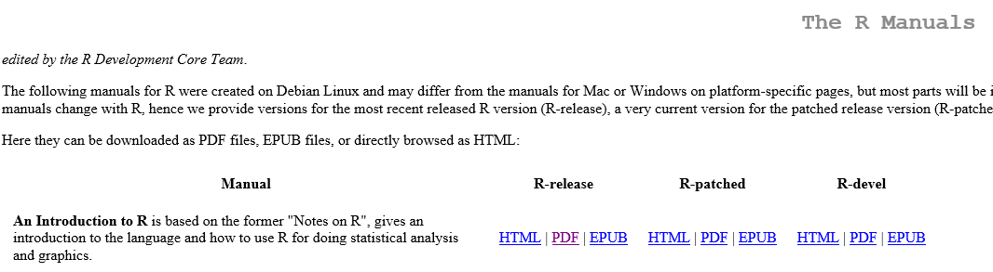

Slide 6
线性回归 Linear regression

Slide 7
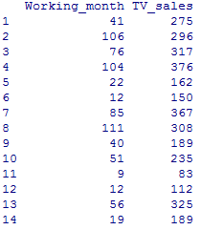
Read the data into R
Example1=read.csv("E:\\数据分析和统计软件\\Lecture 3 上机数据\\Example1.csv", header=T, sep=',')
Example1
names(Example1)

Slide 8
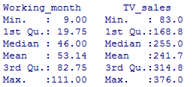

Explore the data
summary(Example1)
cor(Example1)
plot(TV_sales~Working_month, data=Example1)

Slide 9
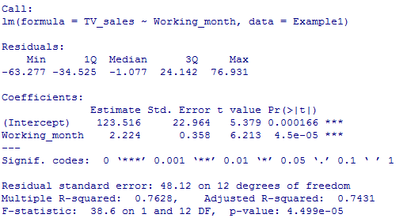
Model specification and estimation
lm1=lm(TV_sales~Working_month, data=Example1)
summary(lm1)

Slide 10
Checking the adequacy of the model
standresid=rstandard(lm1)
plot(standresid~Working_month, data=Example1)

Slide 11
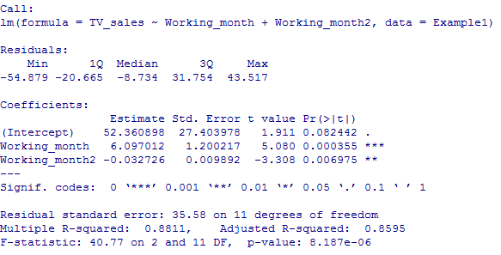
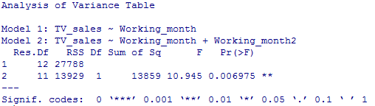
Refit the model
Working_month2=Example1$Working_month^2
lm2=lm(TV_sales~Working_month+Working_month2,data=Example1)
summary(lm2)
anova(lm1,lm2)

Slide 12
Checking the adequacy of the new model: (1) Check for Constant Error Variance
standresid=rstandard(lm2)
plot(standresid~lm1$fitted, data=Example1)

Slide 13
Checking the adequacy of the new model: (2) Check for linearity
plot(standresid~Working_month, data=Example1)

Slide 14
(3) Check for Independence of Errors
n=dim(Example1)[1]
index=seq(1:n)
plot(standresid~index)

Slide 15
(4) Check for normality
library(car)
qqPlot(lm2,main="QQ Plot")

Slide 16
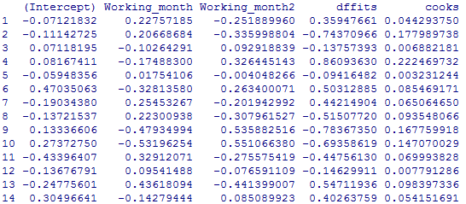
(5) Check for Influential Observations
dfbetas=dfbetas(lm2)
dffits=dffits(lm2)
cooks=cooks.distance(lm2)
cbind(dfbetas,dffits,cooks)

Slide 17
dfbetasPlots(lm2)
par(mfrow=c(1,2))
plot(dffits~index)
plot(lm2, which=c(4))

Slide 18
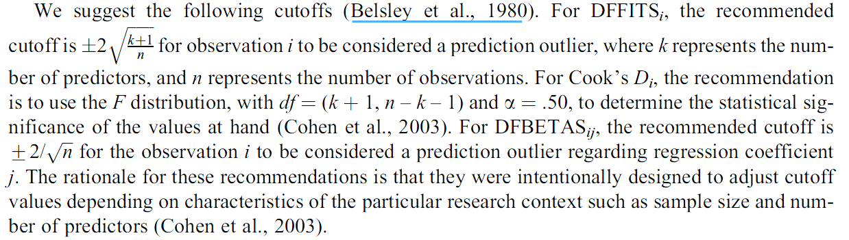


Slide 19
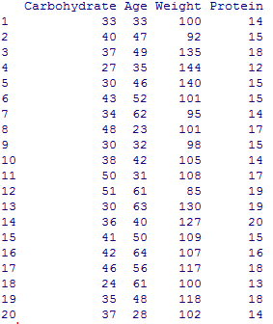
Read the data into R
Example2=read.csv("E:\\数据分析和统计软件\\Lecture 3 上机数据\\Example2.csv", header=T, sep=',')
Example2

Slide 20
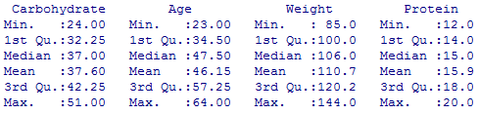

Explore the data
summary(Example2)
cor(Example2)

Slide 21
Explore the data: scatter plot
plot(Carbohydrate ~ Age, data=Example2)
plot(Carbohydrate ~ Weight, data=Example2)
plot(Carbohydrate ~ Protein, data=Example2)

Slide 22
Explore the data: scatter plot
pairs(Example2)

Slide 23
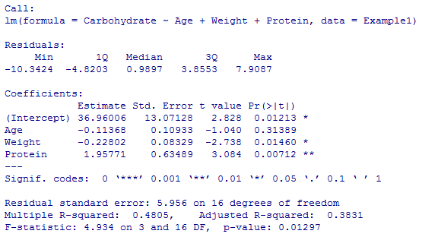
Model specification and estimation
lm1=lm(Carbohydrate ~ Age + Weight + Protein, data=Example2)
summary(lm1)

Slide 24
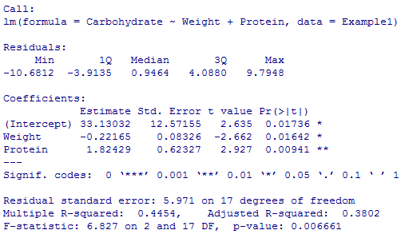
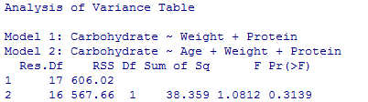
lm2=lm(Carbohydrate ~ Weight + Protein, data = Example1)
summary(lm2)
anova(lm2,lm1)

Slide 25
Checking the adequacy of the model (1) Check for Constant Error Variance
standresid=rstandard(lm2)
plot(standresid~lm2$fitted, data=Example2)

Slide 26
(2) Check for linearity
par(mfrow=c(1,2))
plot(standresid~Weight, data=Example2)
plot(standresid~Protein, data=Example2)

Slide 27
(3) Check for Independence of Errors
n=dim(Example2)[1]
index=seq(1:n)
plot(standresid~index)

Slide 28
(4) Check for normality
qqPlot(lm2,main="QQ Plot")

Slide 29
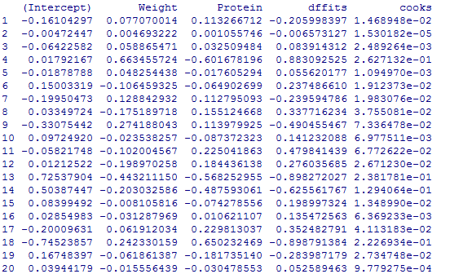
(5) Check for Influential Observations
dffits=dffits(lm2)
dfbetas=dfbetas(lm2)
cooks=cooks.distance(lm2)
cbind(dffits,dfbetas,cooks)

Slide 30
dfbetasPlots(lm2)
par(mfrow=c(1,2))
plot(dffits~index)
plot(lm2, which=c(4))

Slide 31
(6)Check for Multicollinearity
library(car) round(vif(lm2),2)
Weight Protein
1.02 1.02

Slide 32
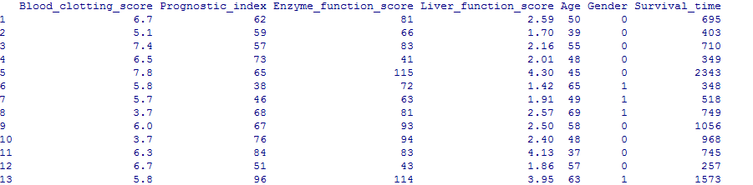
Read the data into R
Example3=read.csv("E:\\数据分析和统计软件\\Lecture 3 上机数据\\Example3.csv", header=T, sep=',')
Example3
names(Example3)
[1] "Blood_clotting_score" "Prognostic_index" "Enzyme_function_score" "Liver_function_score" "Age" "Gender" "Survival_time"

Slide 33
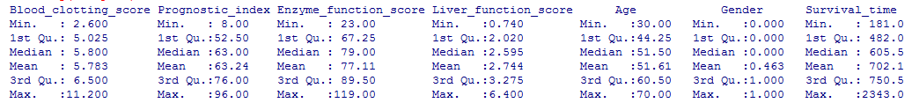
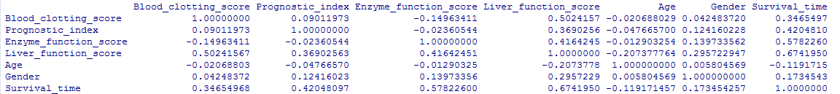
Explore the data
summary(Example3)
cor(Example3)

Slide 34
Explore the data: scatter plot
par(mfrow=c(2,3))
plot(Survival_time~Blood_clotting_score, data=Example3)
plot(Survival_time~Prognostic_index, data=Example3)
plot(Survival_time~Enzyme_function_score, data=Example3)
plot(Survival_time~Liver_function_score, data=Example3)
plot(Survival_time~Age, data=Example3)

Slide 35
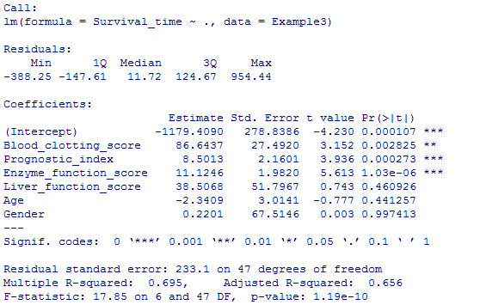
Model specification and estimation
lm1=lm(Survival_time~.,data=Example3)
summary(lm1)

Slide 36
Checking the adequacy of the model
standresid=rstandard(lm1)
plot(standresid~lm1$fitted, data=Example3)

Slide 37
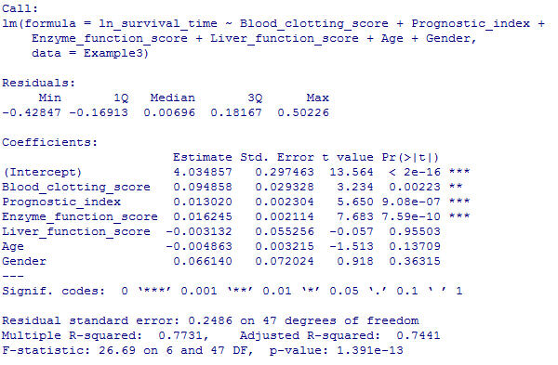
ln_survival_time=log(Example3$Survival_time)
lm2=lm(ln_survival_time~Blood_clotting_score+Prognostic_index+Enzyme_function_score+Liver_function_score+Age+Gender,data=Example3)
summary(lm2)

Slide 38
Checking the adequacy of the model (1) Check for Constant Error Variance
standresid=rstandard(lm2)
plot(standresid~lm2$fitted, data=Example3)

Slide 39
(2) Check for linearity
par(mfrow=c(2,3))
plot(standresid~Blood_clotting_score, data=Example3)
plot(standresid~Prognostic_index, data=Example3)
plot(standresid~Enzyme_function_score, data=Example3)
plot(standresid~Liver_function_score, data=Example3)
plot(standresid~Age, data=Example3)

Slide 40
(3) Check for Independence of Errors
n=dim(Example3)[1]
index=seq(1:n)
plot(standresid~index)

Slide 41
(4) Check for normality
qqPlot(lm2,main="QQ Plot")

Slide 42
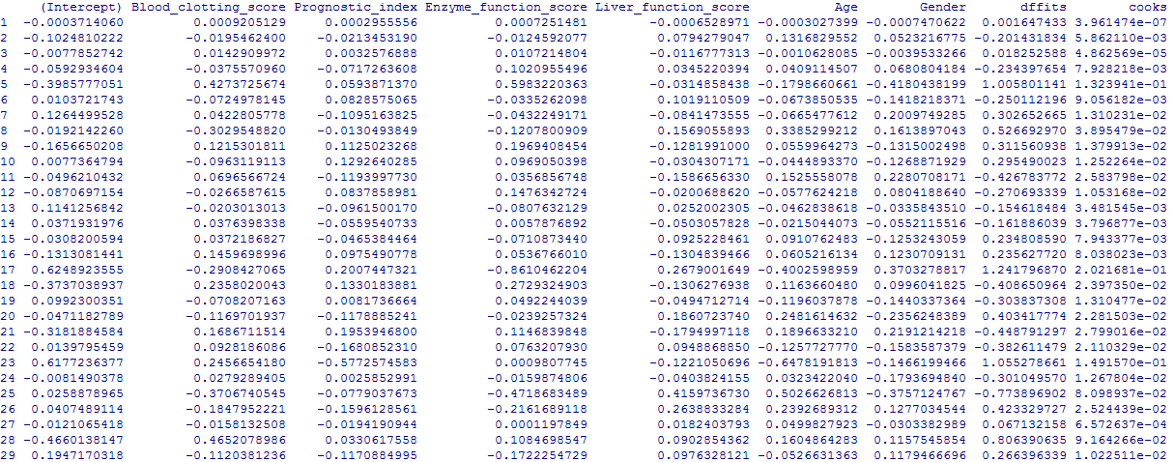
(5) Check for Influential Observations
dfbetas=dfbetas(lm2)
dffits=dffits(lm2)
cooks=cooks.distance(lm2)
cbind(dfbetas,dffits,cooks)

Slide 43
dfbetasPlots(lm2)
par(mfrow=c(1,2))
plot(dffits~index)
plot(lm2, which=c(4))

Slide 44
方差分析 Analysis of variance

Slide 45
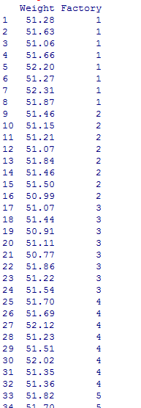
Read the data into R
Example4=read.csv("E:\\数据分析和统计软件\\Lecture 3 上机数据\\Example4.csv", header=T, sep=',')
Example4
names(Example4)

Slide 46

Explore the data
attach(Example4)
tapply(Weight,Factory, mean)
tapply(Weight,Factory, sd)

Slide 47

Model specification and estimation
lm1=aov(Weight ~ as.factor(Factory), data=Example4)
summary(lm1)

Slide 48
Checking the adequacy of the model (1) Check for Constant Error Variance
standresid=rstandard(lm2)
plot(standresid~lm1$fitted, data=Example4)

Slide 49
(2) Check for Independence of Errors
n=dim(Example2)[1]
index=seq(1:n)
plot(standresid~index)

Slide 50
(3) Check for normality
qqPlot(lm2,main="QQ Plot")

Slide 51
(4) Check for Influential Observations
dffits=dffits(lm2)
dfbetas=dfbetas(lm2)
cooks=cooks.distance(lm2)
cbind(dffits,dfbetas,cooks)

Slide 52
dfbetasPlots(lm2)
par(mfrow=c(1,2))
plot(dffits~index)
plot(lm2, which=c(4))

Slide 53
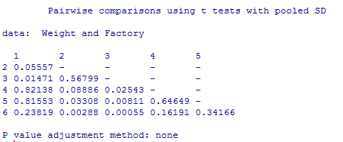
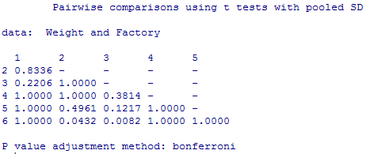
多重比较
pairwise.t.test(Weight, Factory, p.adj = "none", data=Example4)
pairwise.t.test(Weight, Factory, p.adj = "bonf", data=Example4)

Slide 54
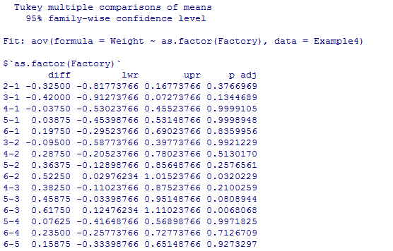
TukeyHSD(lm1)

Slide 55
协方差分析 Analysis of covariance

Slide 56
Practice1:广告长度与效果
在电视出现的早期，大多数商业广告的时间都是60秒。但现在，商业广告可以任意长短的。商业广告的目的—尽可能的让更多的观众记住产品的正面形象，并最终购买该产品。一项实验研究了商业广告的时间与观众对其记忆的关系。随机挑选了60位观众，让他们观看1小时的电视节目，在电视节目的中间，插播一个某品牌牙刷的商业广告。有些观众看到的广告为20秒，有些是24秒、28秒……60秒不等。观看完节目后，对每位观众进行一个测试，衡量他们记住了产品的多少内容，并打分（满分为30分）。

Slide 57
Practice2: 游乐园游客数量
一家游乐园的经理希望能够预测日游客数量，以便更准确地计划每日订购多少食品和雇佣多少位驾驶员。考虑后，这位经理认为下面三个变量最为关键：
前一天游客数量
工作日或周末
天气预报
接下来他随机挑选出40天，记录了当天的游客数量、前一天游客数量、是否是周末（周末code为1 ，其它为0 ），天气预报情况（晴天code为1，其它为0）。

